Slide 1
MGS 723: Geodynamics
Classes 17 and 18: Fluid Mechanics I
Content sourced from: i) Turcotte and Schubert, Geodynamics, ii) England and Katz Oxford notes, iii) Becker and Kaus, Numerical Geodynamics

Slide 2
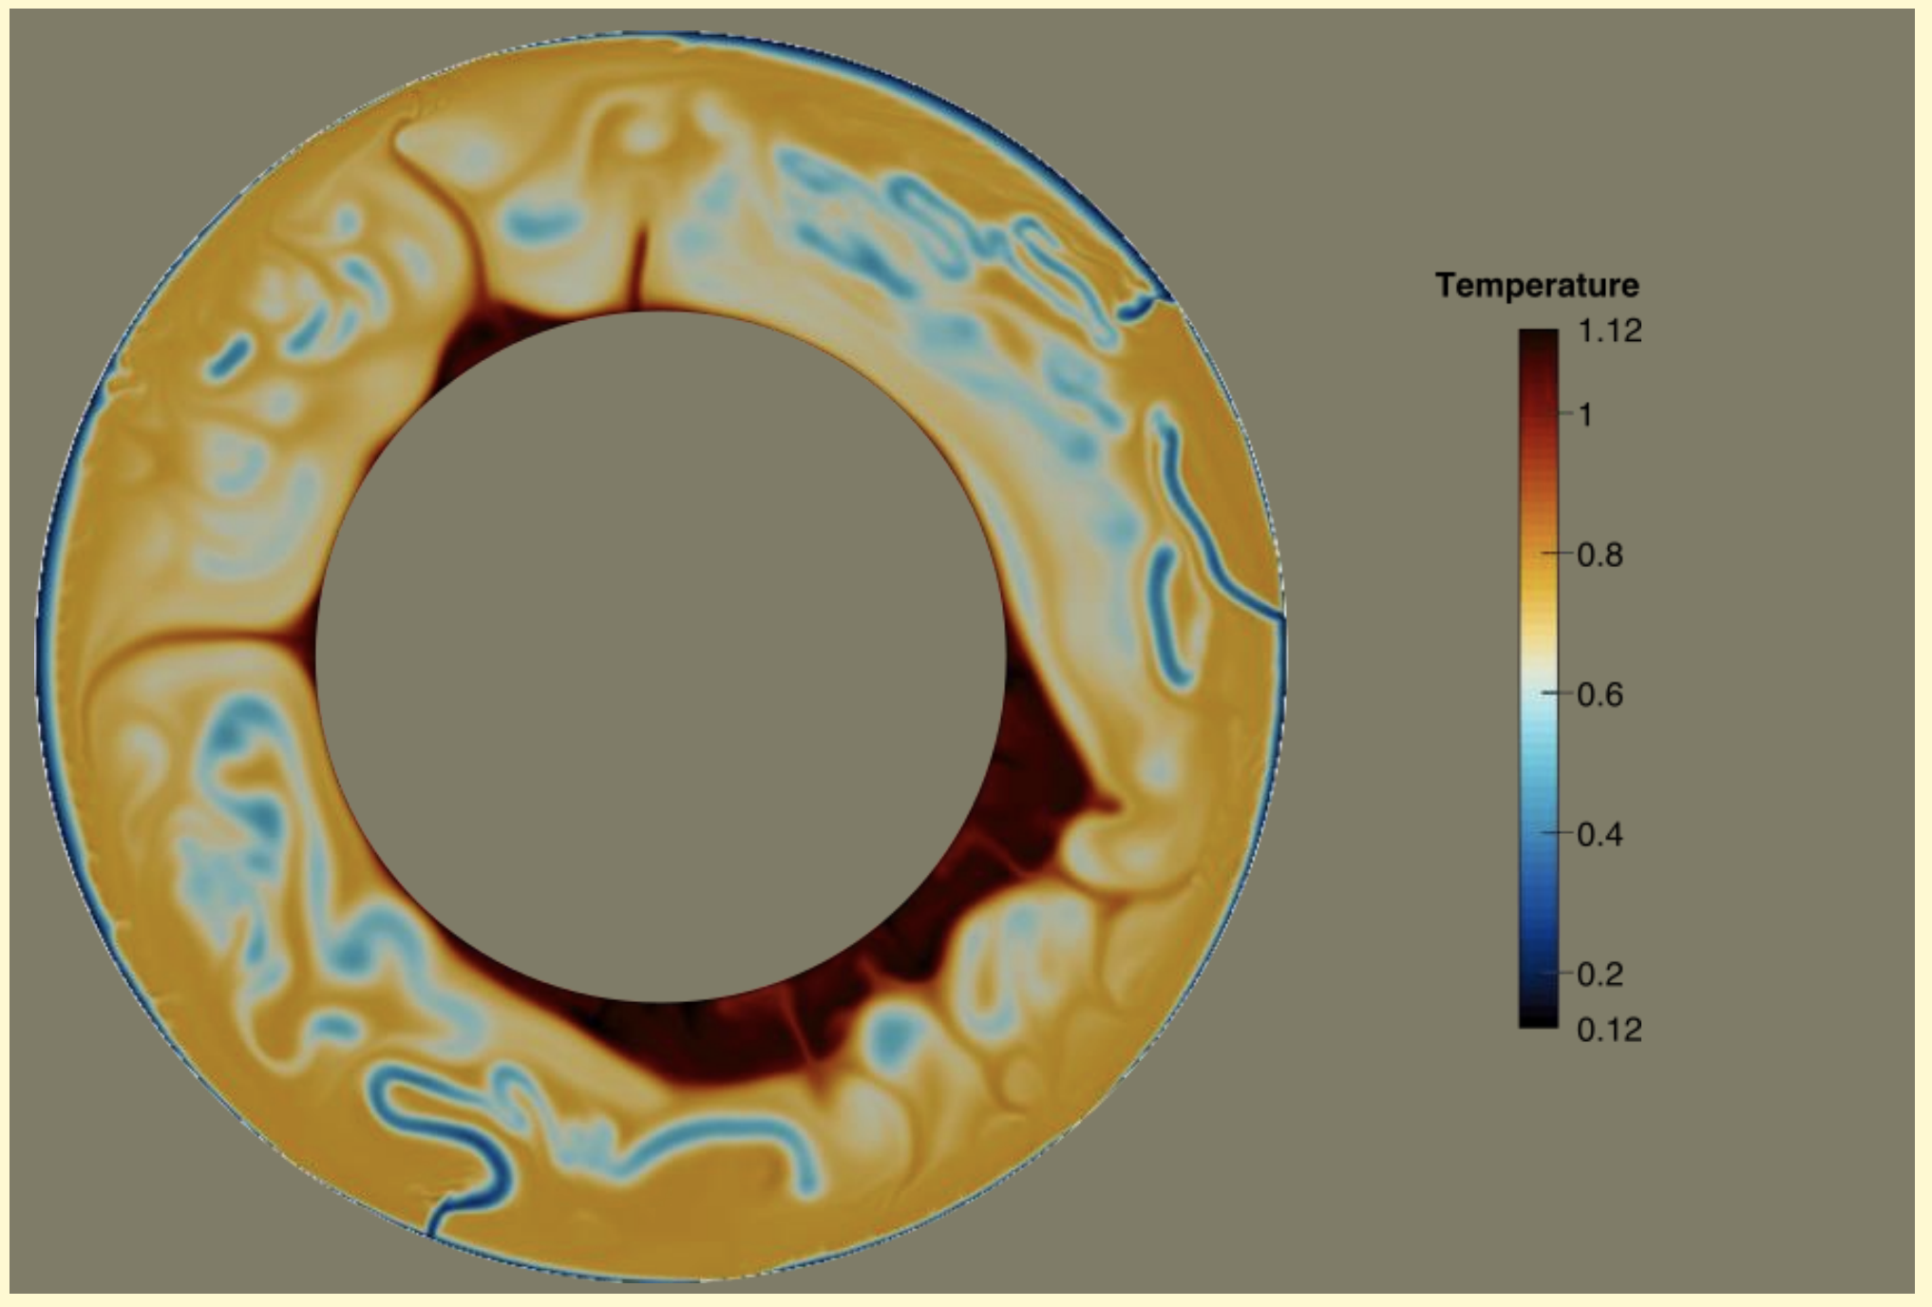
Motivation: Most of the Earth is a fluid over timescales of a few thousands of yrs or greater

Slide 3
Motivation: Most of the Earth is a fluid over timescales of a few thousands of yrs or greater
Describe using a viscous rheology ($σ∝\dot{ε}$)

Slide 4
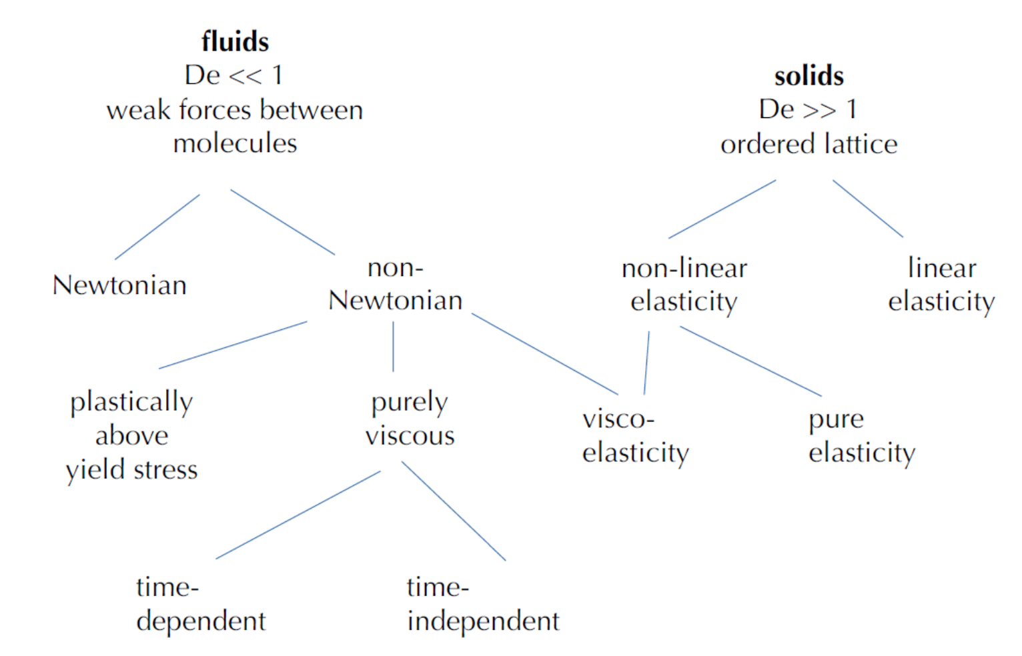
Viscous flow

Slide 5
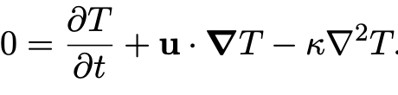
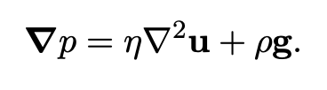
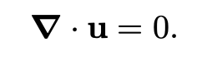
Fluid deformation: The conservation equations
(For an incompressible, Newtonian fluid without inertia)

Slide 6
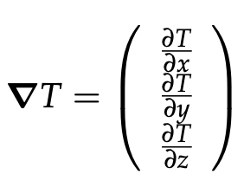
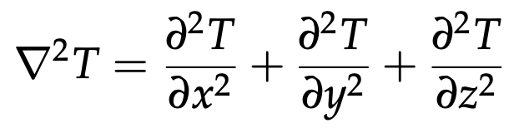
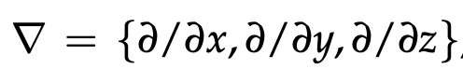
Fluid deformation: The conservation equations
(For an incompressible, Newtonian fluid without inertia)

Slide 7
Fluid deformation: The conservation equations
(For an incompressible, Newtonian fluid without inertia)
Cons. of energy

Slide 8
Fluid deformation: The conservation equations
(For an incompressible, Newtonian fluid without inertia)
Cons. of momentum

Slide 9
Fluid deformation: The conservation equations
(For an incompressible, Newtonian fluid without inertia)
Cons. of mass
(mass continuity equation)

Slide 10

To the stylus…
Derive mass continuity equation

Slide 11
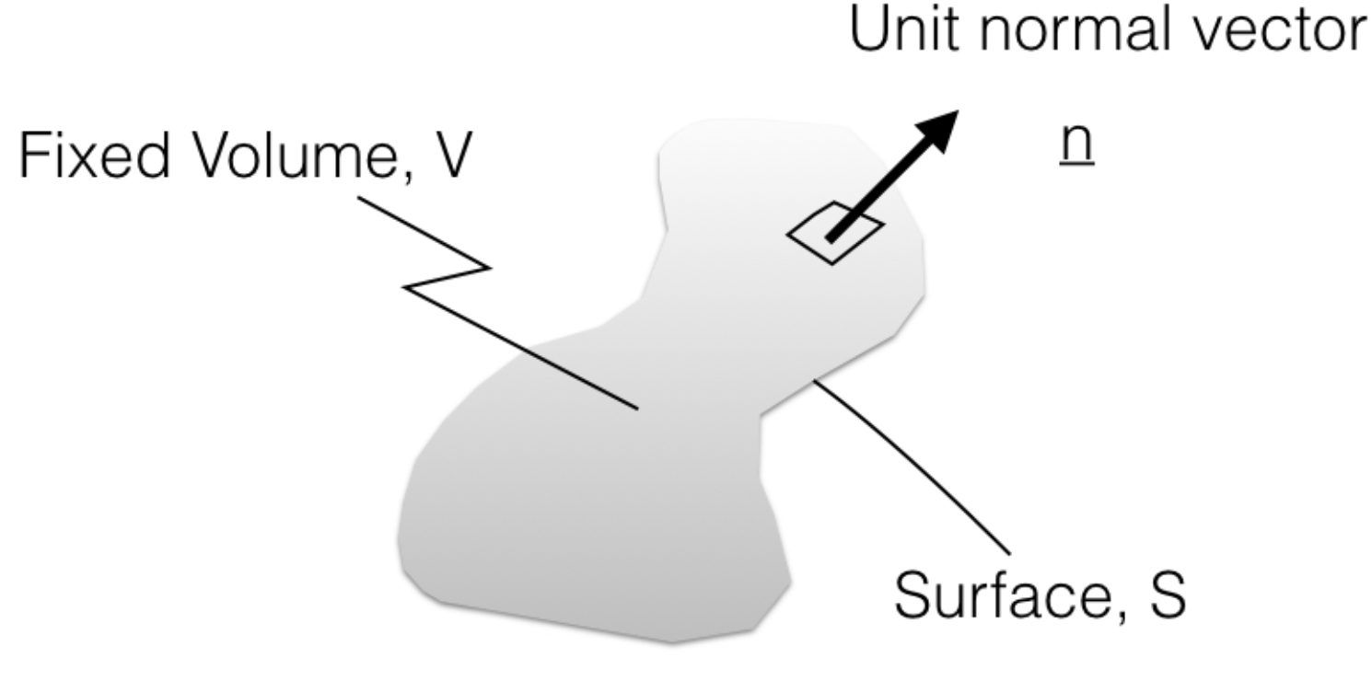
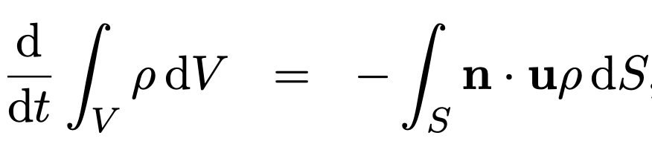
Continuity Equation
A more concise way to derive the same equation:
Consider a fixed volume of arbitrary shape:
Change in mass within volume
Mass flowing across the surface
England and Katz, Univ. of Oxford

Slide 12
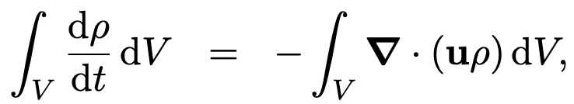
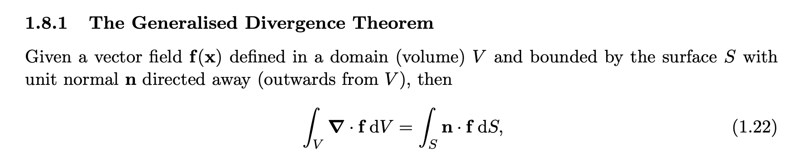
Continuity Equation
A more concise way to derive the same equation:
Consider a fixed volume of arbitrary shape:
(Divergence theorem)
England and Katz, Univ. of Oxford

Slide 13
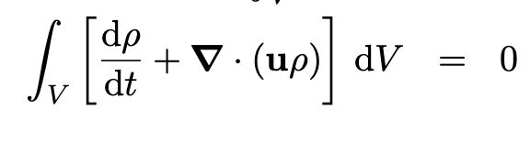
Continuity Equation
A more concise way to derive the same equation:
Consider a fixed volume of arbitrary shape:
England and Katz, Univ. of Oxford

Slide 14
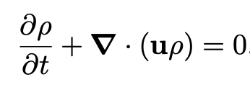
Continuity Equation
A more concise way to derive the same equation:
Consider a fixed volume of arbitrary shape:
England and Katz, Univ. of Oxford

Slide 15
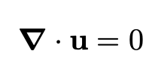
Continuity Equation
A more concise way to derive the same equation:
Consider a fixed volume of arbitrary shape:
Incompressible, steady
England and Katz, Univ. of Oxford

Slide 16
Fluid deformation: The conservation equations
Cons. of momentum

Slide 17
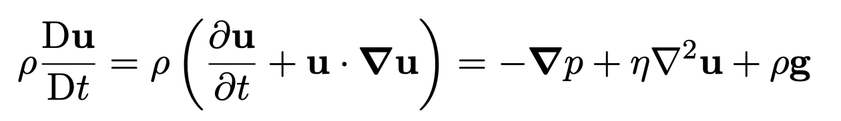
The conservation of (linear) momentum
The Navier-Stokes Equation for Newtonian fluid:

Slide 18
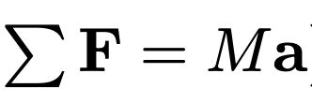
The conservation of (linear) momentum
The Navier-Stokes Equation for Newtonian fluid:
Based on Newton’s 2nd law:

Slide 19
The conservation of (linear) momentum
The Navier-Stokes Equation for Newtonian fluid:
Based on Newton’s 2nd law:

Slide 20
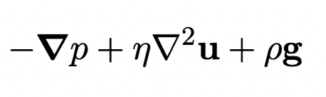
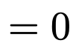
The conservation of (linear) momentum
The Navier-Stokes Equation for Newtonian fluid:
Based on Newton’s 2nd law:
In the mantle, we can assume inertial forces are small (justification later…), and so this simplifies to:

Slide 21
The conservation of (linear) momentum
The Navier-Stokes Equation for Newtonian fluid:
Based on Newton’s 2nd law:
In the mantle, we can assume inertial forces are small (justification later…), and so this simplifies to:
Stokes flow for a Newtonian fluid without inertia (appropriate for creeping, high viscosity flows)

Slide 22
To the stylus…
Derive Stokes equation

Slide 23

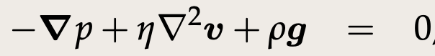
What we derived (Stokes flow for incompressible, Newtonian fluid):
Vector form:

Slide 24
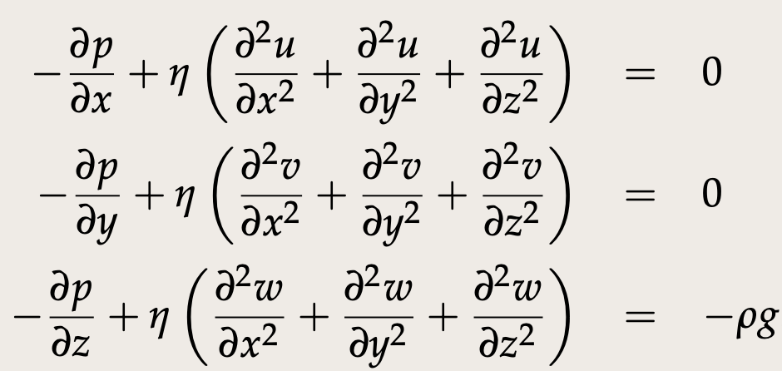
What we derived (Stokes flow for incompressible, Newtonian fluid):
Vector form:
In full (Cartesian):

Slide 25
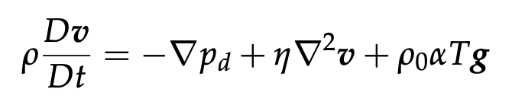
What we derived (Stokes flow for incompressible, Newtonian fluid):
Vector form:
In full (Cartesian):
If we don’t neglect inertial terms (~acceleration), we have Navier-Stokes flow:

Slide 26
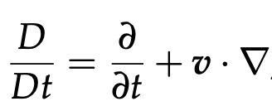
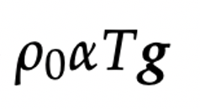
What we derived (Stokes flow for incompressible, Newtonian fluid):
Vector form:
In full (Cartesian):
If we don’t neglect inertial terms (~acceleration), we have Navier-Stokes flow:
Where i) D/Dt is the total, Lagrangian derivative:
ii) And describes a T-dependent density

Slide 27
What we derived (Stokes flow for incompressible, Newtonian fluid):
Vector form:
In full (Cartesian):
If we don’t neglect inertial terms (~acceleration), we have Navier-Stokes flow:
So why can we neglect this first, inertial term in the mantle?

Slide 28
Non-dimensionalization
We can non-dimensionalize equations using “characteristic” quantities. Each variable is then divided by the right combination of characteristic quantities to make them non-dimensional (unitless):
Becker and Kaus, Numerical Geodynamics

Slide 29
Non-dimensionalization
We can non-dimensionalize equations using “characteristic” quantities. Each variable is then divided by the right combination of characteristic quantities to make them non-dimensional (unitless):
Consider the Navier-Stokes equation:
Becker and Kaus, Numerical Geodynamics

Slide 30
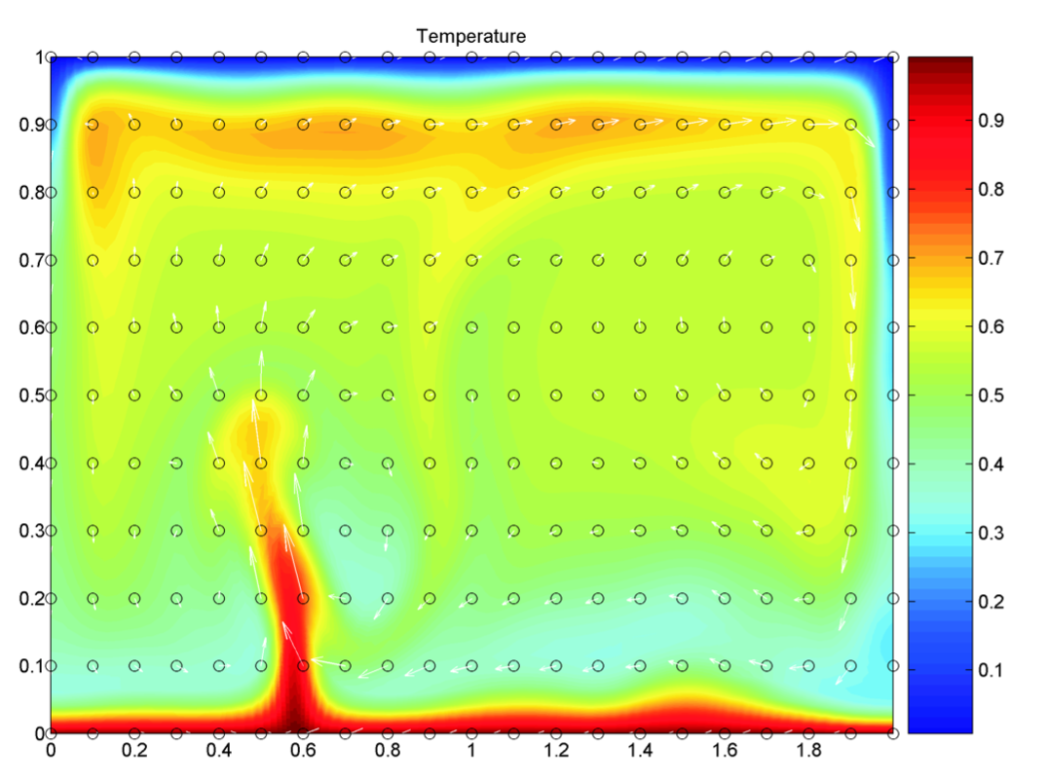
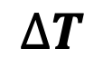
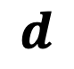

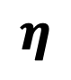
Non-dimensionalization
We can non-dimensionalize equations using “characteristic” quantities. Each variable is then divided by the right combination of characteristic quantities to make them non-dimensional (unitless):
Consider the Navier-Stokes equation:
We choose characteristic quantities (e.g., v_{c} for a characteristic velocity) depending on the problem that we set up/want to solve. E.g., for convection in a box:
$$d$$
$$η$$
$$κ$$
$$∆T$$
Becker and Kaus, Numerical Geodynamics

Slide 31
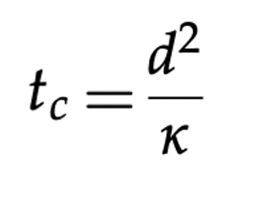
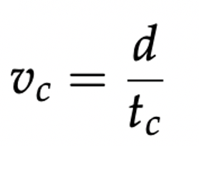
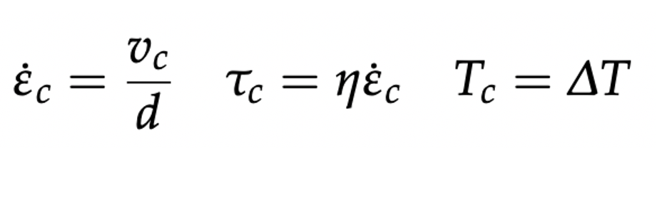
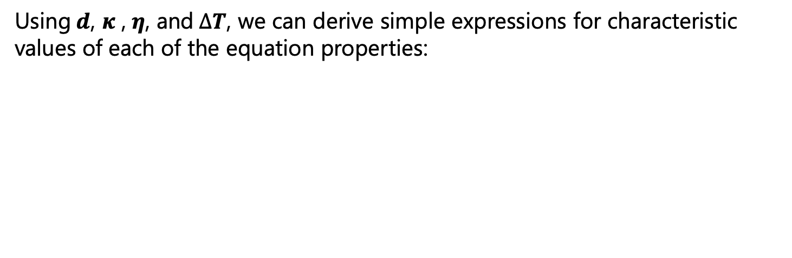
Non-dimensionalization
Using$d$, $κ$ , $η$, and $∆T$, we can derive simple expressions for characteristic values of each of the equation properties:
Becker and Kaus, Numerical Geodynamics

Slide 32
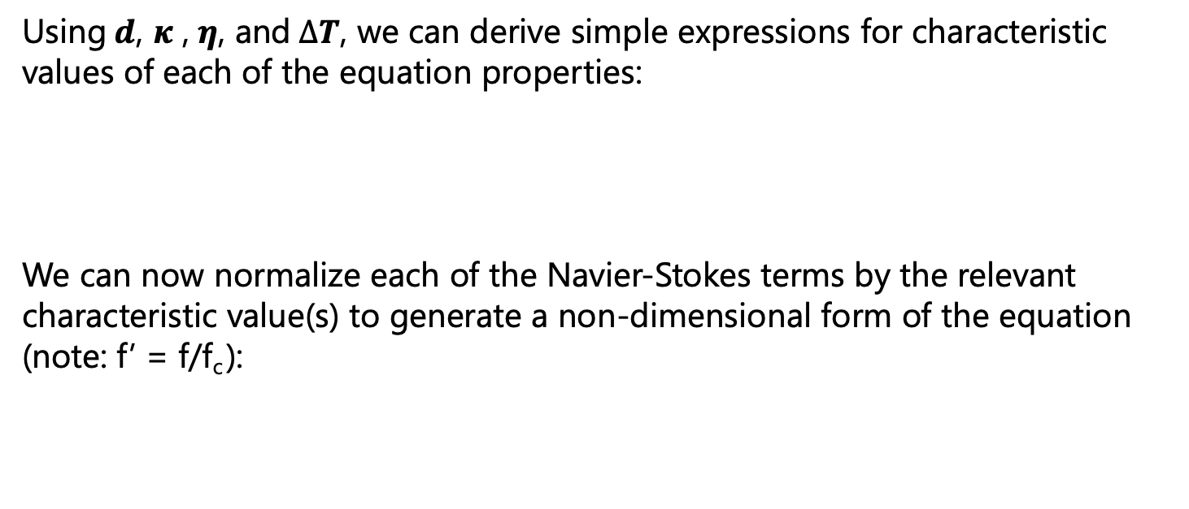
Non-dimensionalization
Using$d$, $κ$ , $η$, and $∆T$, we can derive simple expressions for characteristic values of each of the equation properties:
We can now normalize each of the Navier-Stokes terms by the relevant characteristic value(s) to generate a non-dimensional form of the equation (note: f’ = f/f_{c} ):
dimensional
Becker and Kaus, Numerical Geodynamics

Slide 33
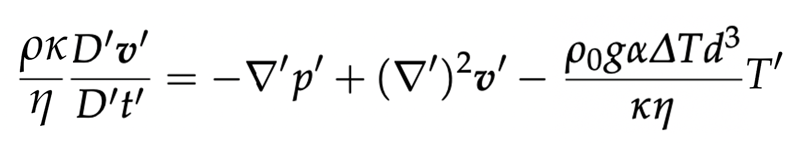
Non-dimensionalization
Using$d$, $κ$ , $η$, and $∆T$, we can derive simple expressions for characteristic values of each of the equation properties:
We can now normalize each of the Navier-Stokes terms by the relevant characteristic value(s) to generate a non-dimensional form of the equation (note: f’ = f/f_{c} ):
dimensional
non-dimensional
Becker and Kaus, Numerical Geodynamics

Slide 34
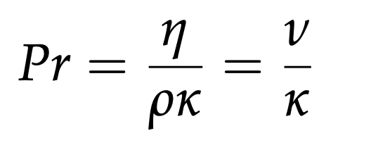
Non-dimensionalization
Using$d$, $κ$ , $η$, and $∆T$, we can derive simple expressions for characteristic values of each of the equation properties:
We can now normalize each of the Navier-Stokes terms by the relevant characteristic value(s) to generate a non-dimensional form of the equation (note: f’ = f/f_{c} ):
dimensional
1/Pr #
non-dimensional
The Prandtl Number
Becker and Kaus, Numerical Geodynamics

Slide 35
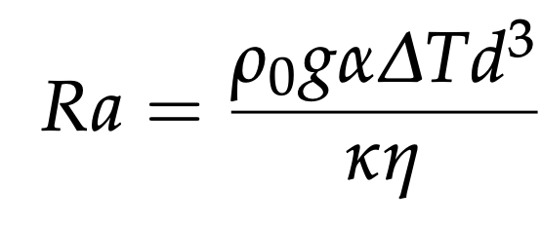
Non-dimensionalization
Using$d$, $κ$ , $η$, and $∆T$, we can derive simple expressions for characteristic values of each of the equation properties:
We can now normalize each of the Navier-Stokes terms by the relevant characteristic value(s) to generate a non-dimensional form of the equation (note: f’ = f/f_{c} ):
dimensional
1/Pr #
Ra #
non-dimensional
The Prandtl Number
The Rayleigh
Number

Slide 36
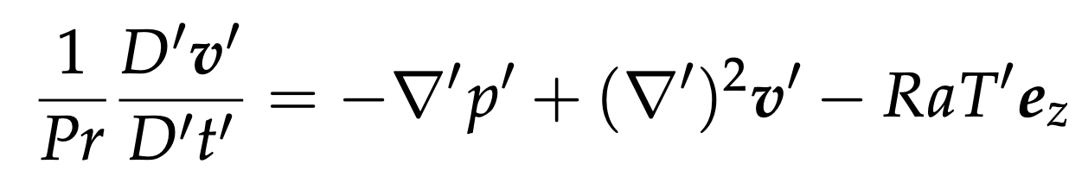
Non-dimensionalization
Using$d$, $κ$ , $η$, and $∆T$, we can derive simple expressions for characteristic values of each of the equation properties:
We can now normalize each of the Navier-Stokes terms by the relevant characteristic value(s) to generate a non-dimensional form of the equation (note: f’ = f/f_{c} ):
dimensional
non-dimensional

Slide 37
Non-dimensionalization
What is the approx. Prandtl number for Earth’s mantle?

Slide 38

Non-dimensionalization
What is the approx. Prandtl number for Earth’s mantle?
$$≈ \frac{{10}^{21}}{3×{10}^{3}.{10}^{−6}}=\frac{1}{3}{10}^{24}$$

Slide 39
Non-dimensionalization
What is the approx. Prandtl number for Earth’s mantle?
The Prandtl number compares the diffusion of momentum and the diffusion of heat. Pr >>> 1 shows that momentum diffuses much faster than heat.
$$≈ \frac{{10}^{21}}{3×{10}^{3}.{10}^{−6}}=\frac{1}{3}{10}^{24}$$

Slide 40
Non-dimensionalization
What is the approx. Prandtl number for Earth’s mantle?
The Prandtl number compares the diffusion of momentum and the diffusion of heat. Pr >>> 1 shows that momentum diffuses much faster than heat. We can therefore neglect terms with 1/Pr, which leads to the Stokes equation without inertia (aka: infinite Prandtl number approximation)
$$≈ \frac{{10}^{21}}{3×{10}^{3}.{10}^{−6}}=\frac{1}{3}{10}^{24}$$

Slide 41

Non-dimensionalization
What is the approx. Prandtl number for Earth’s mantle?
The Prandtl number compares the diffusion of momentum and the diffusion of heat. Pr >>> 1 shows that momentum diffuses much faster than heat. We can therefore neglect terms with 1/Pr, which leads to the Stokes equation without inertia (aka: infinite Prandtl number approximation)
What is the approx. Rayleigh number for Earth’s mantle?
$$≈ \frac{{10}^{21}}{3×{10}^{3}.{10}^{−6}}=\frac{1}{3}{10}^{24}$$
$$≈ \frac{3×{10}^{3}.10.{10}^{−5}.{10}^{3}.{({3×10}^{6})}^{3}}{{10}^{−6}{.10}^{21}}≈{10}^{6}$$

Slide 42
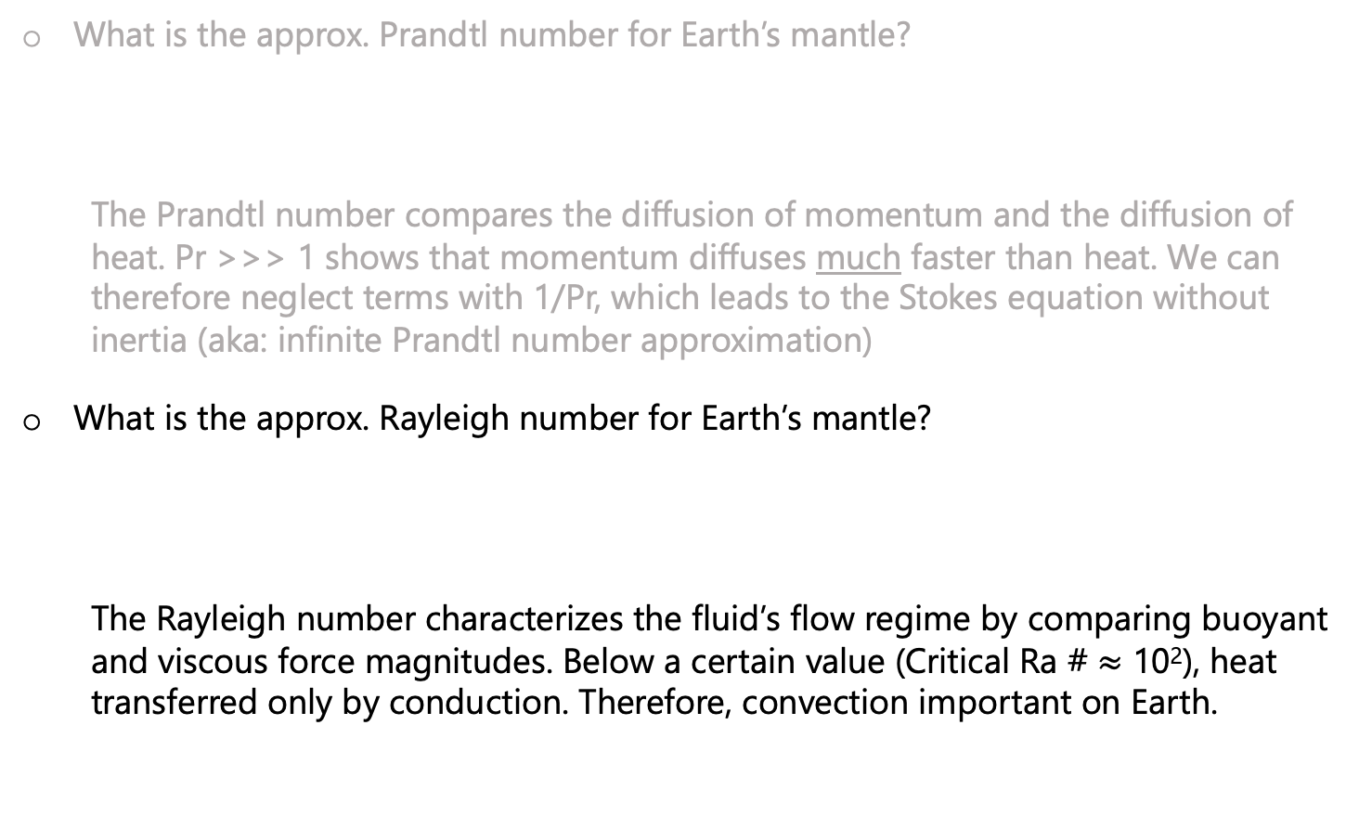
Non-dimensionalization
What is the approx. Prandtl number for Earth’s mantle?
The Prandtl number compares the diffusion of momentum and the diffusion of heat. Pr >>> 1 shows that momentum diffuses much faster than heat. We can therefore neglect terms with 1/Pr, which leads to the Stokes equation without inertia (aka: infinite Prandtl number approximation)
What is the approx. Rayleigh number for Earth’s mantle?
The Rayleigh number characterizes the fluid’s flow regime by comparing buoyant and viscous force magnitudes. Below a certain value (Critical Ra # $≈$ 10²), heat transferred only by conduction. Therefore, convection important on Earth.
$$≈ \frac{{10}^{21}}{3×{10}^{3}.{10}^{−6}}=\frac{1}{3}{10}^{24}$$
$$≈ \frac{3×{10}^{3}.10.{10}^{−5}.{10}^{3}.{({3×10}^{6})}^{3}}{{10}^{−6}{.10}^{21}}≈{10}^{6}$$

Slide 43
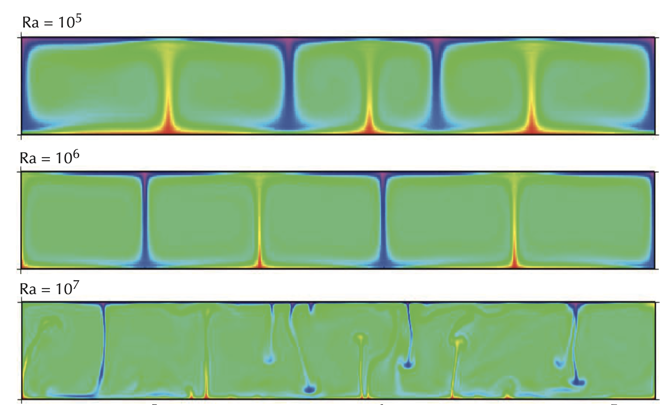
Rayleigh number
Increasing Ra # increases the convective vigor
Becker and Kaus, Numerical Geodynamics

Slide 44
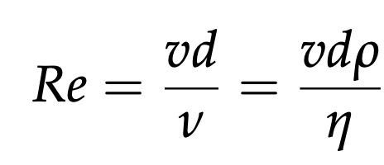
A few other important non-dimensional numbers…
Inertial forces
Reynolds number:
Measures: How important inertial terms are relative to stresses (note overlap with Pr #). For Earth’s mantle Re ~10⁻²². Further justification for using Stokes.
viscous forces

Slide 45
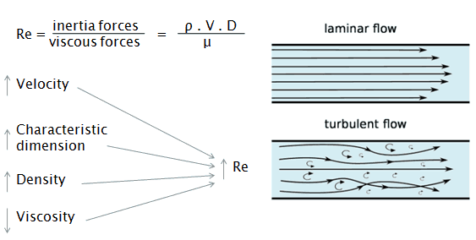
A few other important non-dimensional numbers…
Inertial forces
Reynolds number:
Measures: How important inertial terms are relative to stresses (note overlap with Pr #). For Earth’s mantle Re ~10⁻²². Further justification for using Stokes.
viscous forces
Low Re
High Re
England and Katz, Univ. of Oxford

Slide 46
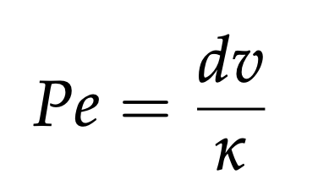
A few other important non-dimensional numbers…
Reynolds number:
Peclet number:
Measures: How important inertial terms are relative to stresses (note overlap with Pr #). For Earth’s mantle Re ~10⁻²². Further justification for using Stokes.
advective rate
Measures advective vs. diffusive heat transport (analogous, and can be transformed into, the Rayleigh number)
diffusive rate

Slide 47
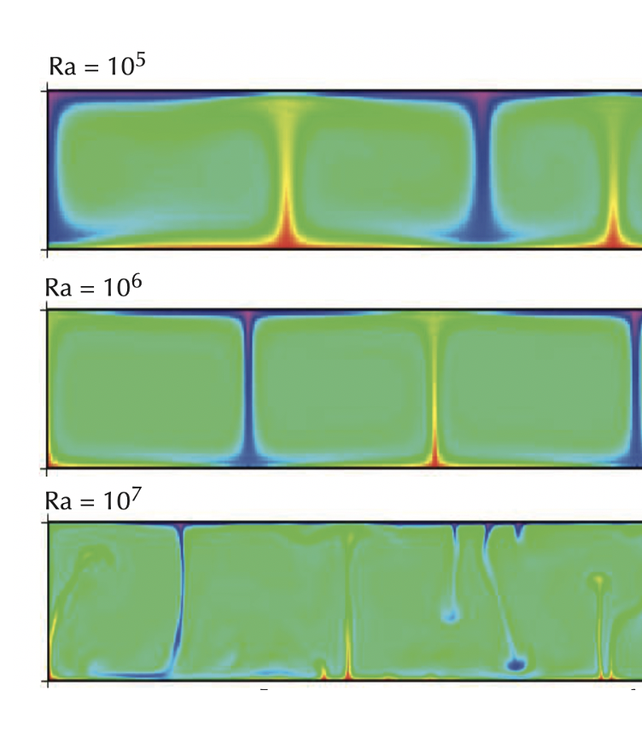
A few other important non-dimensional numbers…
Reynolds number:
Peclet number:
Measures: How important inertial terms are relative to stresses (note overlap with Pr #). For Earth’s mantle Re ~10⁻²². Further justification for using Stokes.
advective rate
Measures advective vs. diffusive heat transport (analogous, and can be transformed into, the Rayleigh number)
diffusive rate
Low Pe
High Pe

Slide 48
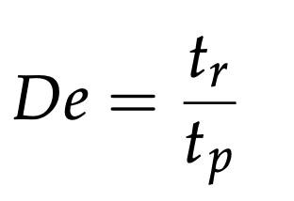
A few other important non-dimensional numbers…
Reynolds number:
Peclet number:
Deborah number:
Measures: How important inertial terms are relative to stresses (note overlap with Pr #). For Earth’s mantle Re ~10⁻²². Further justification for using Stokes.
advective rate
Measures advective vs. diffusive heat transport (analogous, and can be transformed into, the Rayleigh number)
diffusive rate
Measures solid vs. fluid deformation of material undergoing deformation for t_{p}. De << 1 gives fluid behavior (e.g., in mantle, De ~ 10⁻⁵)

Slide 49
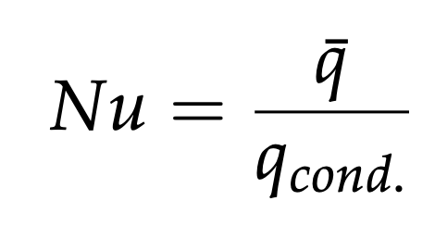
A few other important non-dimensional numbers…
Reynolds number:
Peclet number:
Deborah number:
Nusselt number:
Measures: How important inertial terms are relative to stresses (note overlap with Pr #). For Earth’s mantle Re ~10⁻²². Further justification for using Stokes.
advective rate
Measures advective vs. diffusive heat transport (analogous, and can be transformed into, the Rayleigh number)
diffusive rate
Measures solid vs. fluid deformation of material undergoing deformation for t_{p}. De << 1 gives fluid behavior (e.g., in mantle, De ~ 10⁻⁵)
total
Measures relative importance of conductive heat transport. Scales with the Rayleigh number, e.g., Nu ~ Ra^{1/3} for simple convection.
conductive

Slide 50
Take homes:
Three conservation equations (mass, momentum, energy) need to describe fluid flow. (Three unknowns: pressure, velocity, temperature)
For mantle convection, we can drop the inertial term from the conservation of momentum: Stokes equations.
We also often assume incompressibility (cons. of mass becomes divergence of velocity = 0).
Non-dimensional of equations a very useful tool.
Important non-dim numbers: Pr, Ra, Pe, Re, Nu, De

